Slide 1



IE412 AI for Finance: Mini Project 2
Portfolio optimization with machine learning prediction model
TA: Yoontae Hwang
yoontae@unist.ac.kr
UNIST Financial Engineering Lab.

Slide 2
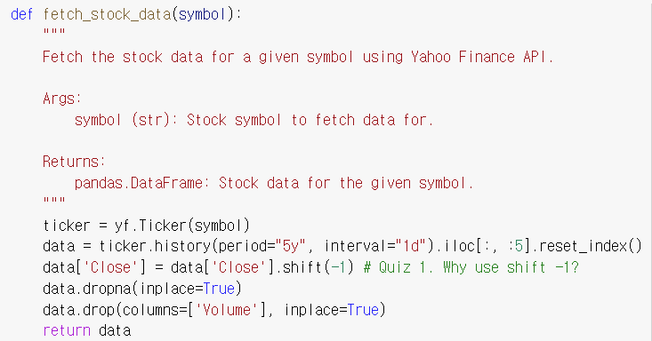

Portfolio optimization code tutorial
1
Tutorial overview - Collecting data: Quiz 1
Fetch the stock data for a given symbol using Yahoo Finance API.
- We choose 5 stocks for this tutorial: (Starbucks, Apple, Walmart, JP Morgan, Pfizer)
SBUX, AAPL, WMT, JPM, PFE
Notice that each quiz is not the main problem.
However, the quizzes are sub-problems that you might want to think about.

Slide 3
Portfolio optimization code tutorial
1
Tutorial overview – Split data
Split the stock data into train, validation, and test sets.
Input variable : Open, High, Low, Close (time t-1)
Target variable : Close (time t)
Train period
Valid period
Test period
881 days
(2018-04-30 to 2021-10-26)
252 days
(2021-10-27 to 2022-10-26)
125 days
(2022-10-27 to 2023-04-27)
Why use the split strategy? The reason for splitting data into training, validation, and test sets is to ensure that our model can learn from the data, generalize well to unseen examples, and have its performance accurately evaluated.

Slide 4
Portfolio optimization code tutorial
1
Tutorial overview – Split data
Split the stock data into train, validation, and test sets.
Training set: This is the largest portion of the dataset, used to train the model by adjusting its parameters to minimize the error or loss function. The model learns patterns and features from this data to make predictions or classifications.
Dataset
Validation set: This subset of the data is used to fine-tune the model's hyperparameters and select the best performing model during the training process. It helps prevent overfitting by ensuring that the model generalizes well to new, unseen data, and it helps us compare different models or model architectures.
Training set
Validation set
Test set
Test set: The test set is an independent dataset that is not used during the training process. It is utilized to evaluate the final performance of the model, providing an unbiased assessment of how well the model generalizes to real-world, unseen data.
Training process

Slide 5
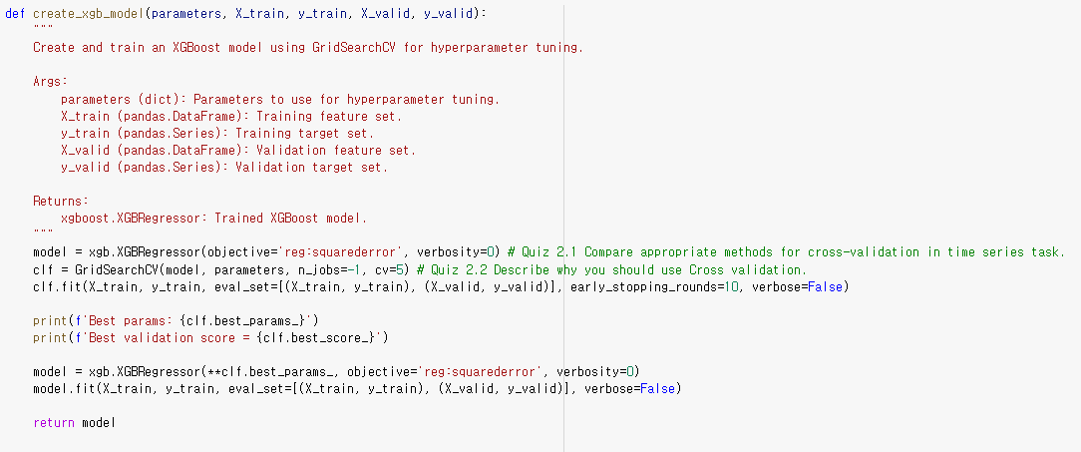
Portfolio optimization code tutorial
1
Tutorial overview – Split data : Quiz 2.1, 2.2
To ensure that your model generalizes well to new, unseen data, you may want to create different validation sets. In particular, with time series, an incorrect validation set can lead to model overfitting.

Slide 6



Portfolio optimization code tutorial
1
Tutorial overview – Model
This tutorial provides an example of XGboost and LSTM (optional).
We won't go into the details of model architecture, but there are some very helpful websites that can help you out.
Dacon Tutorial
Kaggle
Dive into Deep learning (free)
https://dacon.io/hackathon
https://www.kaggle.com/competitions
https://d2l.ai/

Slide 7
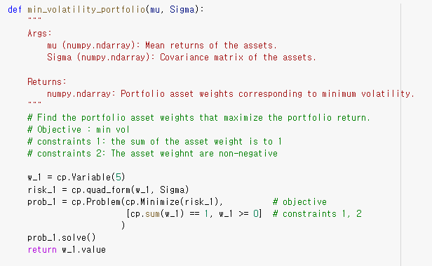
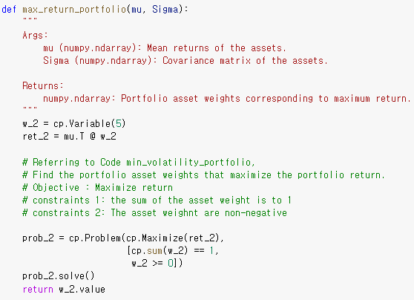
Portfolio optimization code tutorial
1
Tutorial overview – Portfolio optimization
We provide example code for min volatility portfolio and max return portfolio.

Slide 8
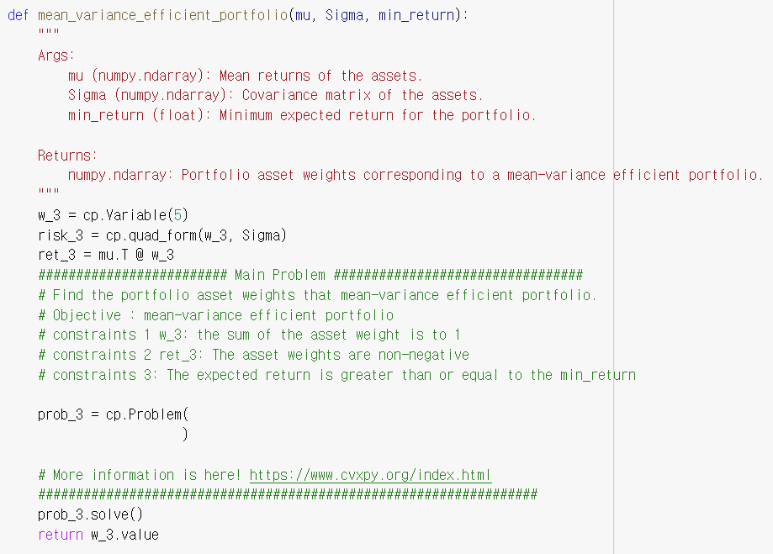
Portfolio optimization code tutorial
1
Tutorial overview – Portfolio optimization : Main task
The main task is to complete the following function and use it to generate mean-variance efficient portfolios.

Slide 9
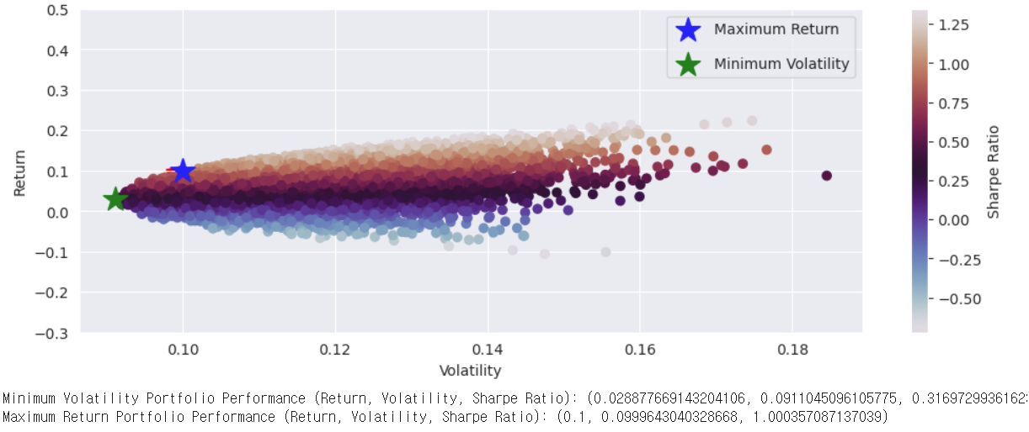
Portfolio optimization code tutorial
1
Tutorial overview – Portfolio optimization
The answers to the following portfolio optimization problems can be found in the provided tutorial file.
If you have solved the main problem correctly, you will get the same results as in the tutorial file.

Slide 10
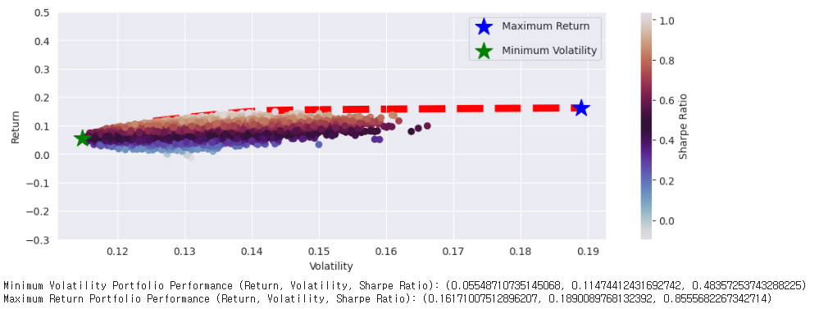
Portfolio optimization code tutorial
1
Tutorial overview – Portfolio optimization : Historical data
This is the result of
Solving Markowitz model with historical mu and Sigma
Evaluating them with historical mu and Sigma

Slide 11
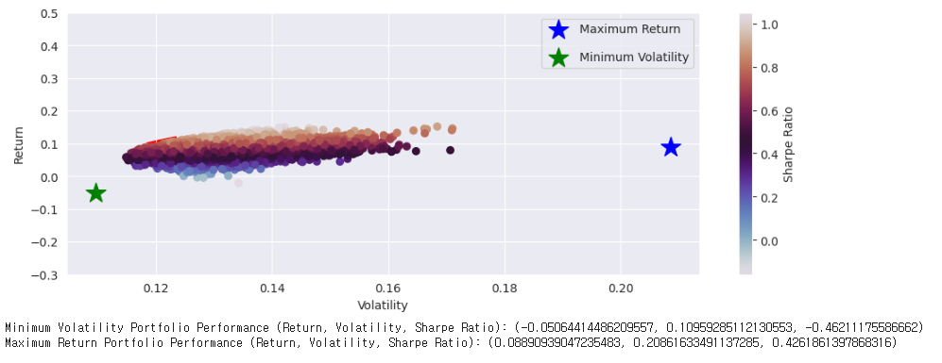
Portfolio optimization code tutorial
1
Tutorial overview – Portfolio optimization : Historical data
This is the result of
Solving Markowitz model with historical mu and Sigma
Evaluating them with actual future mu and Sigma

Slide 12
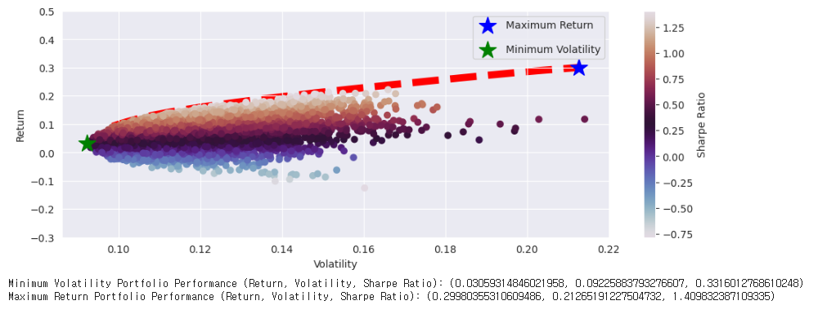
Portfolio optimization code tutorial
1
Tutorial overview – Portfolio optimization : XGboost
This is the result of
Solving Markowitz model with XGBoost predicted mu and Sigma
Evaluating them with XGBoost predicted mu and Sigma

Slide 13
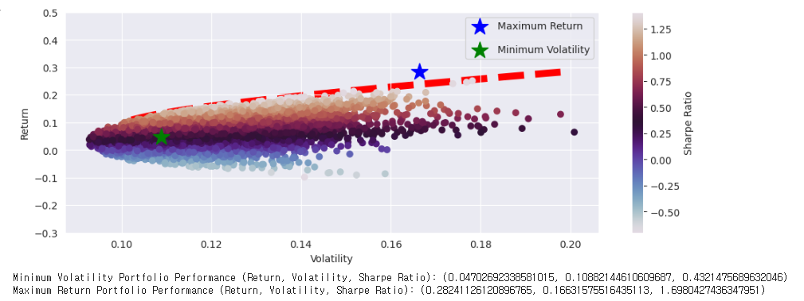
Portfolio optimization code tutorial
1
Tutorial overview – Portfolio optimization : XGboost
This is the result of
Solving Markowitz model with XGBoost predicted mu and Sigma
Evaluating them with actual future mu and Sigma

Slide 14
Portfolio optimization code tutorial
1
Tutorial overview – Portfolio optimization
In short, your task is to draw five more stars in the following four figures in a correct way and discuss the results.

Slide 15

Questions
&
Answers
_
E-mail: yoontae@unist.ac.kr
15

Slide 16
Thank You.

